Slide 1
ABOUT US

Slide 2











ideyaLabs is a Silicon Valley headquartered company focused on Product Engineering, Software Development and Technology Consulting services for technology product companies and innovative enterprises.
ideyaLabs Focus Areas
DIGITAL TRANSFORMATION
IOT
MACHINE LEARNING & ANALYTICS
PRACTICES
MULTI CLOUD SECURITY & COMPLIANCE
OPEN SOURCE INTEGRATION
HYBRID CLOUD/MULTI CLOUD
PRODUCT ENGINEERING
INDUSTRIES
HIGH TECH
FINANCIAL SERVICES
HEALTHCARE &
LIFESCIENCES
TELECOM
AUTOMOTIVE
2
Notes:
Option 1

Slide 3







ideyaLabs Fact Sheet
ideyaLabs is a Silicon Valley based company focused on Product Engineering, SaaS, Enterprise Software development and technology consulting services for technology product companies and innovative SaaS enterprises.
24+ Clients
Over 1200 Releases
750+ Employees
672+ Engineering
8 Locations
ISO 27001-1:2013, ISO 9001:2015, ISO 20001-1:2018, ISO 13485:2016 | SOC2 Compliant
https://www.ideyalabs.com/locations
Notes:
Option 1

Slide 4


















QA Practice
ideyaLabs brings over two decades of experience helping software teams ensure their products, systems, applications, and platforms behave as per the specifications and remain tightly integrated, secure, and compliant. In this, we have developed extensive testing capabilities for various verticals, across platforms, and applications.
KEY TECHNOLOGIES
HTML
JAVA
MANUAL TESTING
AUTOMATED TESTING
CLOUD TESTING
C++
MOBILE TESTING
PHP
PERFORMANCE ENGINEERING

Slide 5


Testing Services Overview
Functional Testing
Mobile Testing
Test Automation
Performance Testing
Security Testing
Functional Testing
Regression Testing
Usability Testing
User Acceptance Testing
Compatibility Testing
Localization Testing
Compliance Testing
Post Production Testing
Android/iOS/BB/Windows
Mobile Apps (Native/Hybrid/Web)
Developer previews
Mobile Automation
Test Automation Consulting
Test Framework setup
Test Design
Test execution & Maintenance
Web Services/APIs
Load Testing &
Capacity assessment
Mobile App Performance
Assessment
Performance Benchmarking
Memory Leak detection
Web Application
Security Testing
Mobile Application
Security Testing
Security Code Review
Network Security Assessment
Testing Center of Excellence (TCoE)
Continuous research | Dedicated labs | Accelerators | Value additions
Test advisory Test Process Assessment, definition & setup Test Automation Advisory & Setup Agile Testing DevOps Advisory

Slide 6
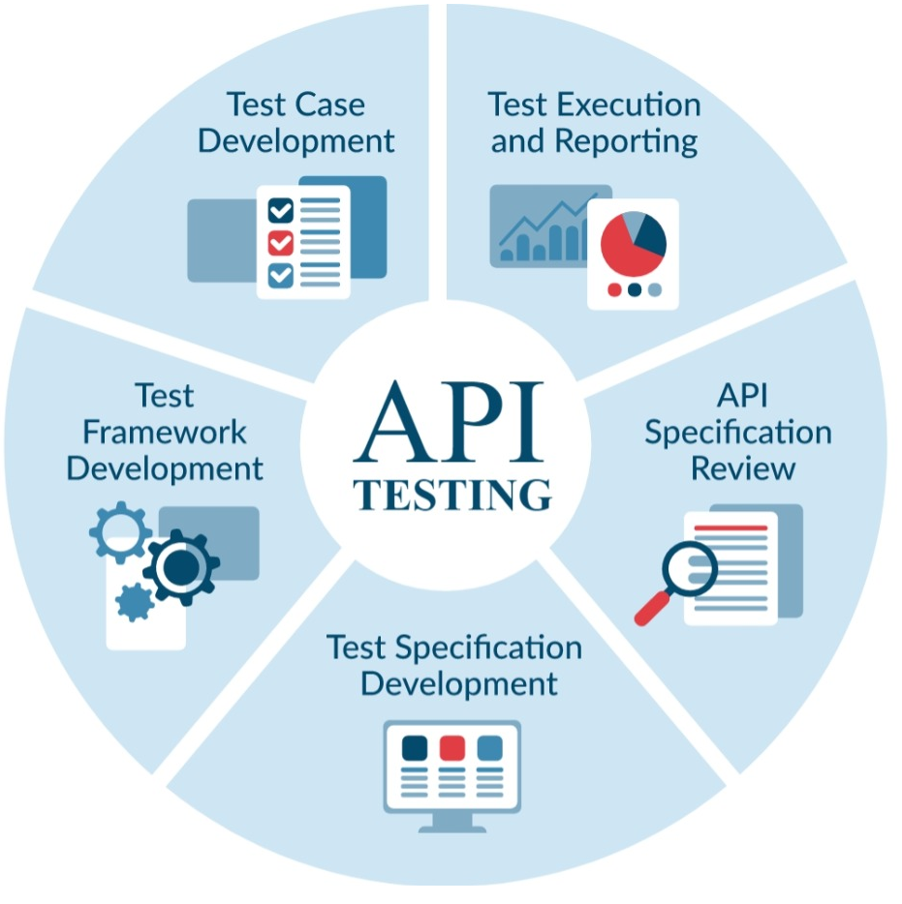


iL – TAF Coverage Areas
API Testing
Integration Testing
System Testing

Slide 7
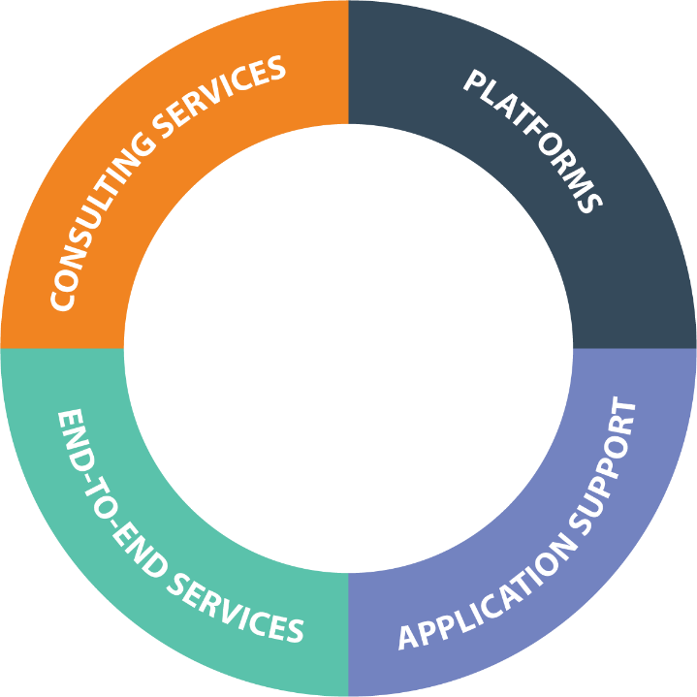


ideyaLabs Automation Testing Services
Readiness Assessment
Target State Recommendations
Application Deployment Roadmap
Business Case
Testing on CT
Web Applications
Mobile, API – SOAP & REST
Cloud Applications such as Salesforce, SAP on Web
Legacy/Desktop Applications
Testing in CI/CD Environments
Functional Test Automation
Test Automation Strategy
Regression identification
Framework Development
Test Script development
Execution env setup
Test Execution and maintenance
Test optimization
Java/.net with standard HTML
JS – Angular, React, node, view
IoS, Android,
Xamarin, Unity

Slide 8
Our Approach to Test Automation
SCRIPT DEVELOPMENT
Develop Scripts iteratively through execution runs
Expert reviews by CoE ensuring code quality
5
6
TEST ENVIRONMENT
Establish Test Environment and Test Data – for the application and Automation Test Execution
4
7
TEST EXECUTION & REPORTING
Execute test cases, analyse results, correct scripts and re-execute, ARES
AUTOMATION TEST PLANNING
Develop Automation Test Plan based on the Automation Framework, Tests and Available resources
FRAMEWORK DEVELOPMENT
Develop/Customize Automation Framework based on the nature of the Application Functionality and business needs
3
8
TEST AUTOMATION OPTIMIZATION
Remove duplicates, Test execution optimization via infrastructure change
2
1
DUE DILIGENCE
Understand Platform/Architecture of the Applications and select Automation tool best suited
FEASIBILITY ANALYSIS
Identify and evaluate feasibility of the Tests that need to be automated, an make suggestion on tool selection
Aligned to Agile
Data-driven
Technology-Agnostic
Multi-Layered
Test Automation can significantly enable organizations to move towards DevOps and Agile through Design for Proactive Automation

Slide 9



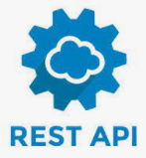






























ideyaLabs Test Automation Ecosystem
Programming Language
Test Management Application
Cloud Infra
Technical SME
Business SME
Managers
Functional UI
API
Mobile
QA Engineers
Frameworks
Tools
Developers
Nunit
Xunit
Code UI
Test NG
Automation SME
Pytest
Junit
Serverless
Custom
Reporting Platforms
Lay Man

Slide 10
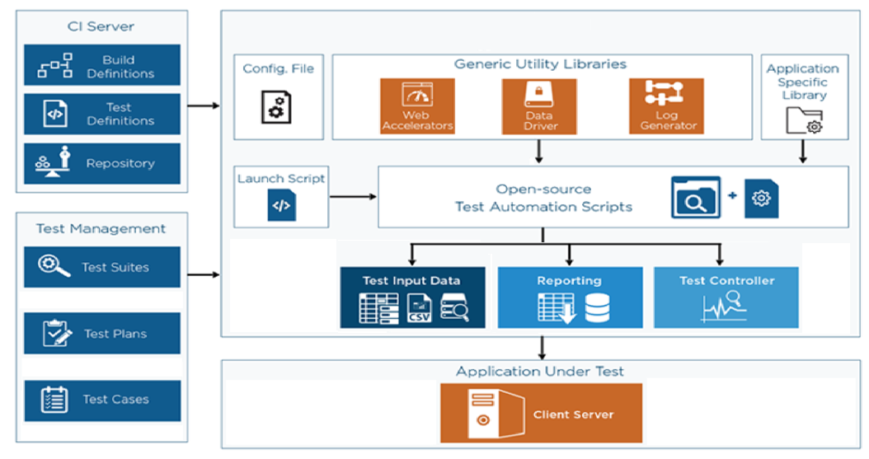
ideyaLabs Test Automation Framework (iTAF)

Slide 11






Advantages of iTAF
No license cost for the Automation Tool and No of licenses
Easy to customize the Framework as per new requirements
We can reduce the turnaround time of fixing issues identified in framework significantly
We can automate the APIs simply by writing test case, test data and test result excel documents
We can easily integrate with CI / CD tools
We can integrate the reporting tool as per customer requirement

Slide 12









Rapid Automation Cycle
Leveraging our approach of Rapid Automation, reduction in testing efforts can be achieved
Work with QA Manager & SME
Identify and brainstorm on test cases prioritization
Work closely with Offshore resource
Provide Training
Onsite Lead
Client QA Manager
ideyaLabs Project Manager
PROJECT PLANNING & PRIORITIZATION
Specialists analyze and review test cases
Identify issues in manual test cases
Remove any gaps for automation
Plan test cases with steps
Prepare test data
ideyaLabs Test Specialist
Advantages
Agile & Extensible
Qualitative Advantage
Reduced Cycle Time & Manual Efforts
Quick and Easy onboarding
Rapid Process Orientation
Better Process Overview for stake holders
Continuous Governance
Test Specialist
TEST PREPARATION & PRE-AUTOMATION
ideyaLabs Automation Engineers
Develop automation scripts
Execute and Test
Build and Deploy
Prepare documentation
SCRIPT DEVELOPMENT
Automation Engineers
Increased Efficiency & Quality

Slide 13
Mobile Application Testing
Device & OS
Browser
Data
Carrier
Network
Device Level Testing
Device Types for Multiple OS Platforms and Fragmentation
Battery utilization
Screen Size, Form Factors, Appearance, Screen Resolutions & available hardware configurations Testing
Conformity to common key functions
Memory Consumption and Performance with different memory size(RAM)
Browser & Data Testing
Cross browser Testing
Metrics measurement like headers, request/response, performance numbers, etc.
Data usage and Performance Testing
Sensitive data storage and validation
Interoperability Testing
Usability Testing
Orientation Testing
Application upgrade and Localization Testing
Network & Carrier Testing
Mobile application compatibility with different networks (CDMA 2000, GSM, W-CDMA, GPRS, etc) and across various carriers.
GSM/UMTS/HSPA Protocol Testing
2G, 3G and 4G device carrier Validation Testing
Network Conditions
Security
Phone Simulator
Device Anywhere
User Agent Strings
HttpWatch - plug-ins for IE and Firefox
DeviceAnywhere
FoneMonkey
Well established, Ready-to-use frameworks for mobile automation testing (Native/Hybrid/Web App)
13

Slide 14
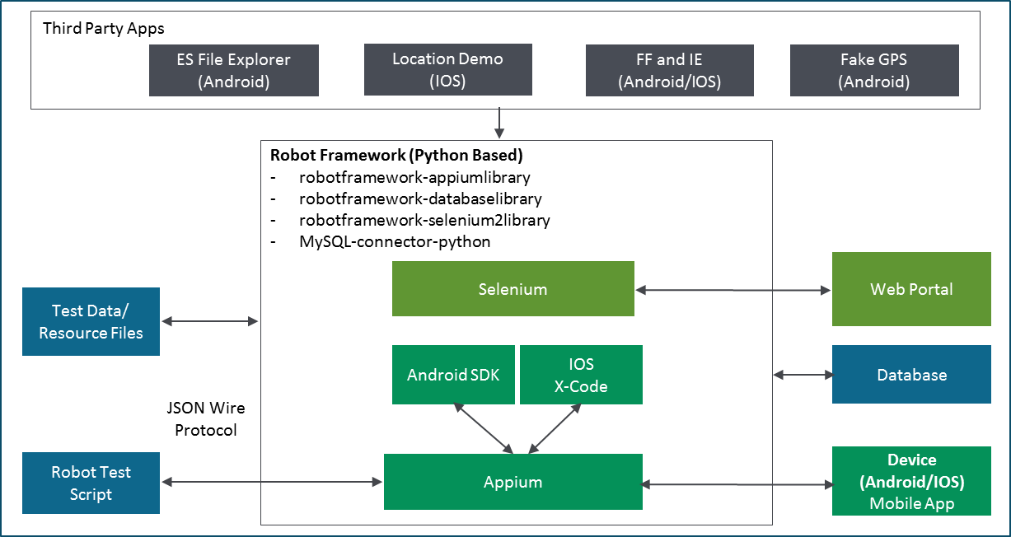




Mobile Automation Testing
ideyaLabs has developed ready-to-use automation framework with a keyword driven approach to support different operating systems and their various respective versions
Platform independent and generates automation scripts for different types of apps
Enables continuous integration and minimizes manual testing efforts
Robust POM (Page Object Model) based Mobile Automation Framework that caters to both Android and IOS Device
Framework developed using Robot, Appium for mobile interaction & Selenium for web interaction
Framework can be customized to suit device specific functions which are done differently per device (E.g. app going to background)
Mobile Automation Framework Design
Calaba.sh

Slide 15
Our Performance testing services offerings
Web Applications (SaaS, Cloud etc.)
Mobile Applications (Native Apps)
Load Testing & Capacity Assessment
Performance Benchmarking
Endurance & Stability Assessment
Memory Profiling & Memory Leak detection
Performance Testing in Continuous Integration
App Performance Assessment
Cross Platform Performance comparison
Load Testing against Mobile App Server
SAP
/Oracle Apps
Media Content
Web Apps
Load Testing
Capacity Assessment
Performance Benchmarking
Endurance & Stability Assessment
Video Streaming User Experience Assessment
Load & Stress Testing with concurrent Media streaming/ downloads

Slide 16
Focus Areas of Security Testing
ideyaLabs would focus on the below areas of Security Testing
Web & Mobile Application
Authentication
Authorization
Input Validation
Client Side Injections
Session Management
Access Control Checks
Parameter Manipulation
Cryptography Issues
Business Logic Testing
MITM Attacks
Source Code Review
Data Access
Validations
Exceptions reviews
Sensitive data Exposure
Poor error handling
Hard-coded secrets
Authentication
Authorization
Network VAPT
Port Scanning
OS Fingerprinting
Service Scanning
Vulnerability Scanning
API & Microservices
Authentication
Authorization
Input Validation
Broken Access Control
Information Disclosure
Lack of Resources & Rate Limiting
Security Misconfiguration
Improper Assets Management
Error Handling
Denial of Service
Identity Management
Session Management
Note: Above are indicative list of tests to be performed and subject to feasibility based on application security posture.

Slide 17
Mindmaps

Slide 18
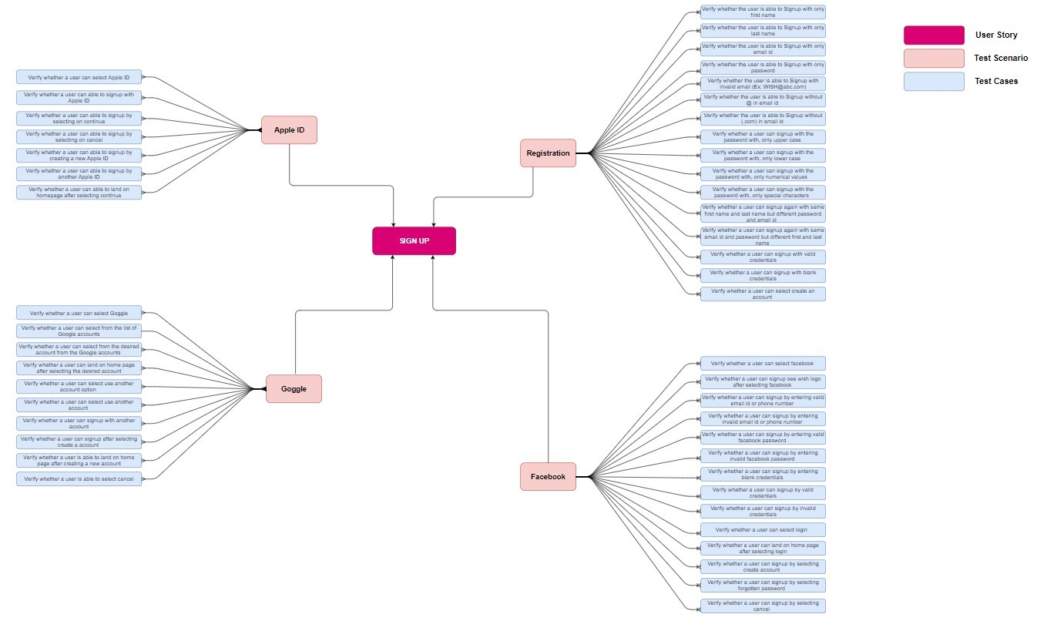
E-commerce – Mind Map Login

Slide 19
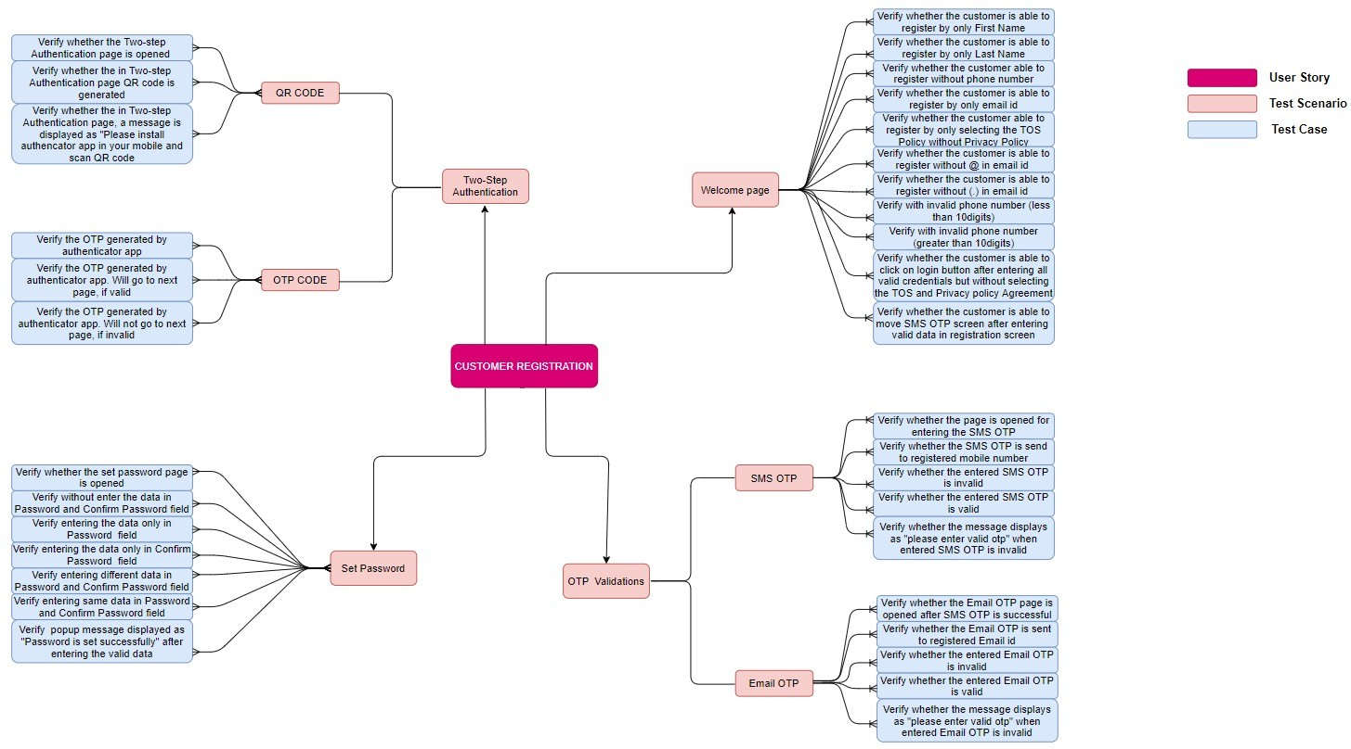
ideyaLabs – Mind Map1 (Customer Registration)

Slide 20
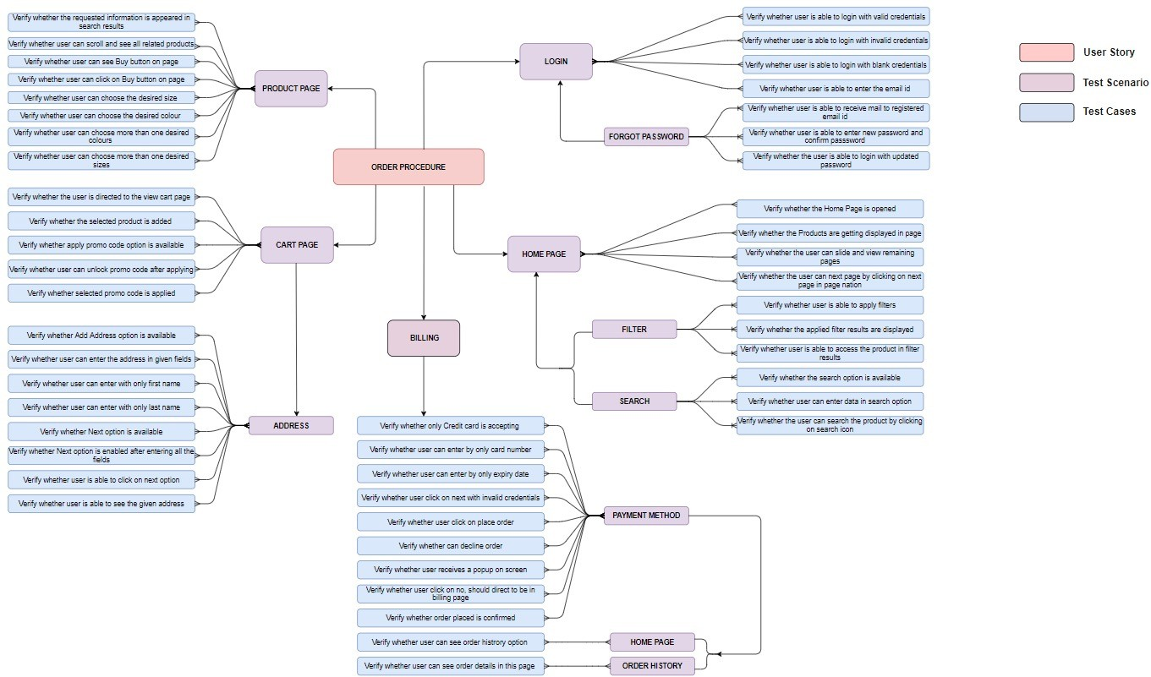
ideyaLabs – Mind Map2 (Product Order Procedure)

Slide 21


Testing Services for Personal Finance Application
BUSINESS PROBLEM AND SCOPE
Personal Finance Company
ideyaLabs developed a growth, training and execution plan to meet client’s requirements
The team comprises of Test management which includes test designers and manual testers and Automation experts
OVERVIEW
Client’s mobile application gives users access to all of their financial information —bank accounts, credit cards, bills, mortgages, loans, and, of course, your credit scores — all in one location, all under one account.
ideyaLabs SOLUTION
ideyaLabs conducted a complete QA cycle in the respective phases for testing the native application across devices and networks
Testing services: Manual Testing, Security Testing, Exploratory Testing, Black Box Testing, Database Testing and Automation
Created complete test plan for both generic and platform test cases
Used Appium for verification of Native apps functionality and UI testing
Appium tool was used for testing across multiple mobile operating systems of iOS and Android with the same automated script
Due to the presence of Selenium webdrive, Appium tool was also used to render support for multiple languages for development (Java, C#)
BUSINESS BENEFITS
Reduced business cycle time, achieved more accuracy and overall operational efficiency
Overnight running test cycle by offshore team saves time
Zero defect leakage
Complied with several federal laws and standards like OWASP
Top 5 rated apps with 5 start reviews
TECHNOLOGY STACK
Jira, TestRail, Confluence, SQL, Android SDK, Selenium, Appium

Slide 22

Health Care Domain - Automation
Leading Health Care Client
ideyaLabs SOLUTION
Functional Tests-
ideyaLabs extensively worked in areas like - Loan Origination, Product & Pricing Services, Consumer Portal, Third Party Origination, Secondary Market, Total Quality, Mortgage CRM, EDS,ECS.
Created a Core team of QA resources supported by Healthcare SMEs for overall Functional & Regression testing of product suite.
Decision table- based Test design approach was followed to ensure that all valid business scenarios are listed and prioritized considering risk associated with functional
Leveraged in-house test data generators and ip tools such as HL7 message generators for realistic test data creation (with wide variety patient demographics and clinical data)
Automated Regression functional areas for expediting Test cycle
OVERVIEW
Leading Healthcare solutions company based out of Canada that provides solutions for Healthcare providers & Long-term care facilities
To ensure that E2E cloud-based workflows are working as expected this automation framework was developed
BUSINESS BENEFITS
Wide range of Products such as ADT systems, Care plan & Incident Management systems, Federal/Provincial Data Reporting tools (CCRS, NRS, OMHRS), Healthcare quality scoring methodologies (RAPs & CAPs ) that need testingAPI Automation – Team has successfully used SOAP UI and SOAP UI Pro version to automate 100% API (SOAP + REST) related test cases
Lack of formal QA process due to shared resources and testing being limited to UAT only (high-level scenarios
OUTCOME
Formalized Testing process for entire product suite of 10+ sub-products, with 100% coverage for test design and several rounds of regression test cycle to uncover critical functional bugs
Test efficiency was improved by utilizing quality test data
Automated P1 and P2 priority regression test cases for most of the products for expediting regression test cycle during each major release

Slide 23


Salesforce – Automation iTAF
Salesforce and software company
BUSINESS PROBLEM AND SCOPE
Application is a complex system with several custom objects and workflows, and limited business process documentation is available to leverage and develop Test suites.
Data flow originates and terminates with 3rd party systems and most of them do not have sandbox/test environment, for validating end-to-end business flows/Integration tests
OVERVIEW
BPaaS services provider for HR and Finance needs, with robust in-house developed platform built on Salesforce for delivering their services
ideyaLabs SOLUTION
We started with understanding business processes with KTs from Business Analysts and Customer Service associate, and Data flow/processing workflows from Dev team (visualizing the custom objects, business logic in APEX code and APIs that integrate with 3rd party systems)
Implemented a two-pronged approach for Testing
End-to-End workflows that closely mimic business processes and data flows (Integration Testing)
Module focused Functional Tests – focused on each individual component – back-end engine/APIs, Salesforce custom objects etc.
Developed a Regression Test suite covering P1 and P2 scenarios for both End-to-End workflows and Functional Tests
Automated 100% of P1 workflows and functional tests, using hybrid framework which has UI, API and SFTP based actions and validations.
BUSINESS BENEFITS
AWS Library can be used with any AWS Automation Project. Plug and Play technique.
The in-house developed application was built using 3 different components of Salesforce – Platform, Service and Communities.
Application has integration with several 3rd party applications such as HRMS suites, Invoicing systems, Banks etc. for via APIs and SFTPs.
A backend engine is developed that takes care of data pull/push from 3rd party systems to/from Salesforce Platform
OUTCOMES
Developed Robust Regression Test Suite that coverage 80% of Key business processes and functional components. (Priority 1 and Priority 2 Test cases)
Automated 100% of P1 Test cases and Integrated them to Build Pipeline (Azure DevOps) for post build validation.

Slide 24


Automation Testing of Mobile Application
Provider of networked crisis communication solutions
BUSINESS PROBLEM AND SCOPE
Large set of Regression Test Cases that needs to be executed on multiple devices and multiple OS versions in limited time frame
QA Taking longer time than Development due to vast scope of Test Cases and Devices
Production Defect Leakage
OVERVIEW
Our Client has comprehensive suite for crisis communications within and between organizations, people, devices, and external entities as to enable informed decisions and effectively protect the people and communities in general
ideyaLabs SOLUTION
Developed an open-source technology based Robust POM (Page Object Model) based Mobile Automation Framework that caters to both Android (version 4.4.4 & onwards in HTC, Motorola, Samsung S4 onwards) and iOS (version 9.0.1 & onwards in iPhone 6 onwards) Devices
Framework was developed using Robot Framework, Appium for mobile related interaction & Selenium for Web Interaction
Single Script for Android and iOS Test Cases handled at Keyword Level
Added 3rd Party apps (ES File Explorer/Location Demo/Fake GPS) for covering edge cases
Integrated Database for DB Level validations of various Mobile App features
Media (Image/Video Uploads) related operations were also incorporated in Automation Scripts and DB Validation
Map related Test Cases were automated using Firefox and DB Validation
BUSINESS BENEFITS
Overnight execution achieved to ensure maximum Test Coverage benefits
Any defect or any anomaly reporting done on devices that may not be used by Manual QA Team.
Immediate detection of any showstopper issues & device related anomalies
Integration with ALM assured standard reporting across all stakeholders
TECHNOLOGY STACK
JSON Wire Protocol, Selenium, Device (Android/IOS), Appium, ES File Explorer, Android SDK, iOS X- Code, Robot Framework, Python

Slide 25
QA for On Demand File Storage Provider
On Demand File Storage Provider
ideyaLabs SOLUTION
ideyaLabs conducted a complete QA cycle in the phases for testing the native application across devices and networks
Created complete test plan for both generic and platform test cases
Used Calabash for verification of native apps functionality and UI testing
Due to the presence of attributes from Ruby and Cucumber, the Calabash tool was used for supporting behavioral testing activities
Used Calabash tool to generate detailed HTML and XML format reports
Configured Calabash with the continuous integration system to eliminate additional debugging steps.
BUSINESS PROBLEM AND SCOPE
Our client application- Native file sharing application for storing, accessing and sharing files of any size and format with colleagues and business partners
The application developed for Android and iOS platforms
TECHNOLOGY STACK
BUSINESS BENEFITS
Jira, TestRail, Confluence, SQL, Android SDK, Selenium, Appium
Reduced business cycle time, achieved more accuracy and overall operational efficiency
Overnight running test cycle by offshore team saves time
Zero defect leakage
Complied with several federal laws and standards like OWASP
Top 5 rated apps with 5 start reviews

Slide 26
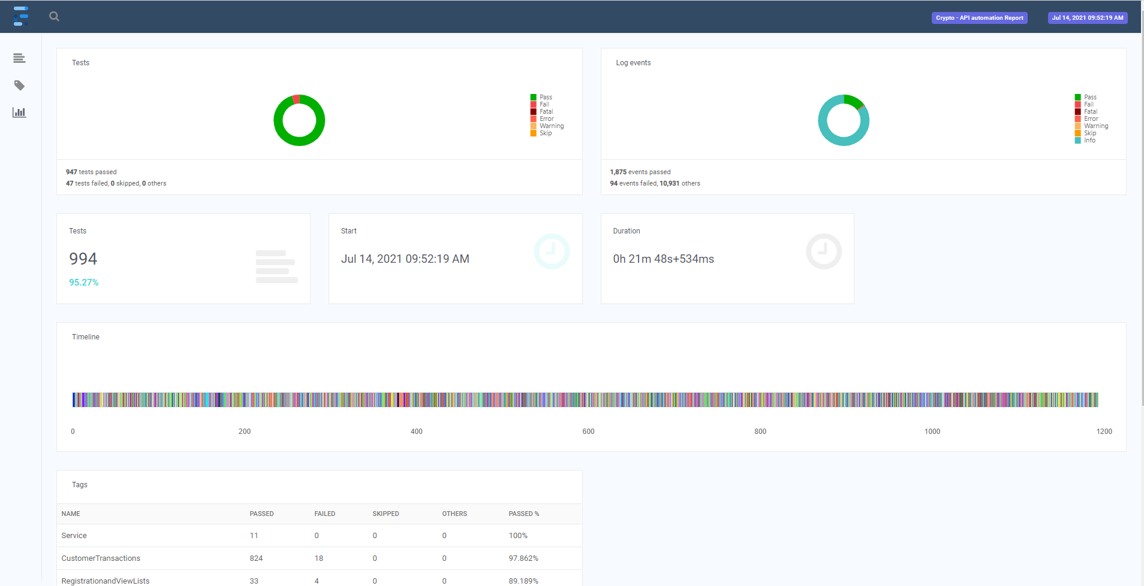
Reports

Slide 27
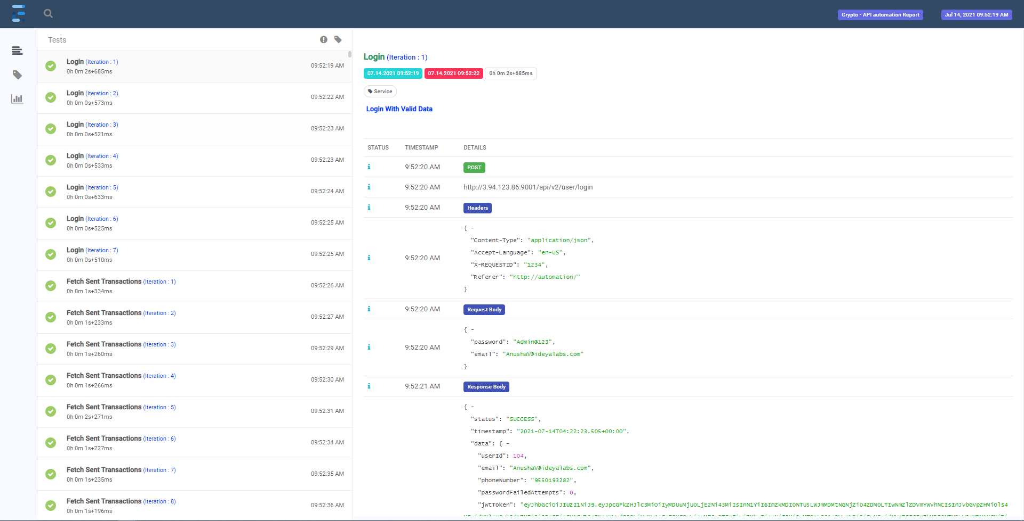
Reports

Slide 28

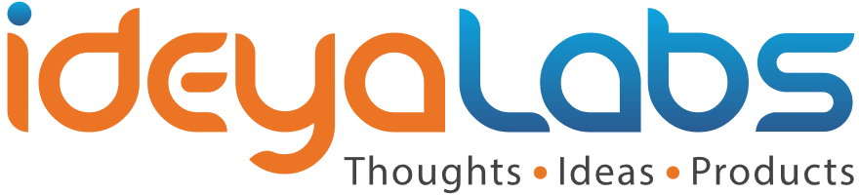
Thank You
© ideyaLabs| www.Ideyalabs.com | Confidential
Contact:
PrasadS@ideyalabs.com

